Slide 1

The Principles of Open Democracy
Hélène Landemore
Yale University
helene.landemore@yale.edu
Notes:
We’re gathered here to talk about consciousness and what it means in today’s world. To me consciousness means the ability to apprehend a problem or a question in all its dimensions and complexity, to see it with great clarity and comprehensiveness. I’m a political theorist and my object, my question is democracy.
What do we mean by democracy? Today we’re accustomed to thinking of it almost exclusively in terms of periodic elections and party competition. But if we zoom out of our particular historical moment and we go all the way back to Ancient Greece, specially 5th and 4th century Athens, it meant something completely different.

Slide 2

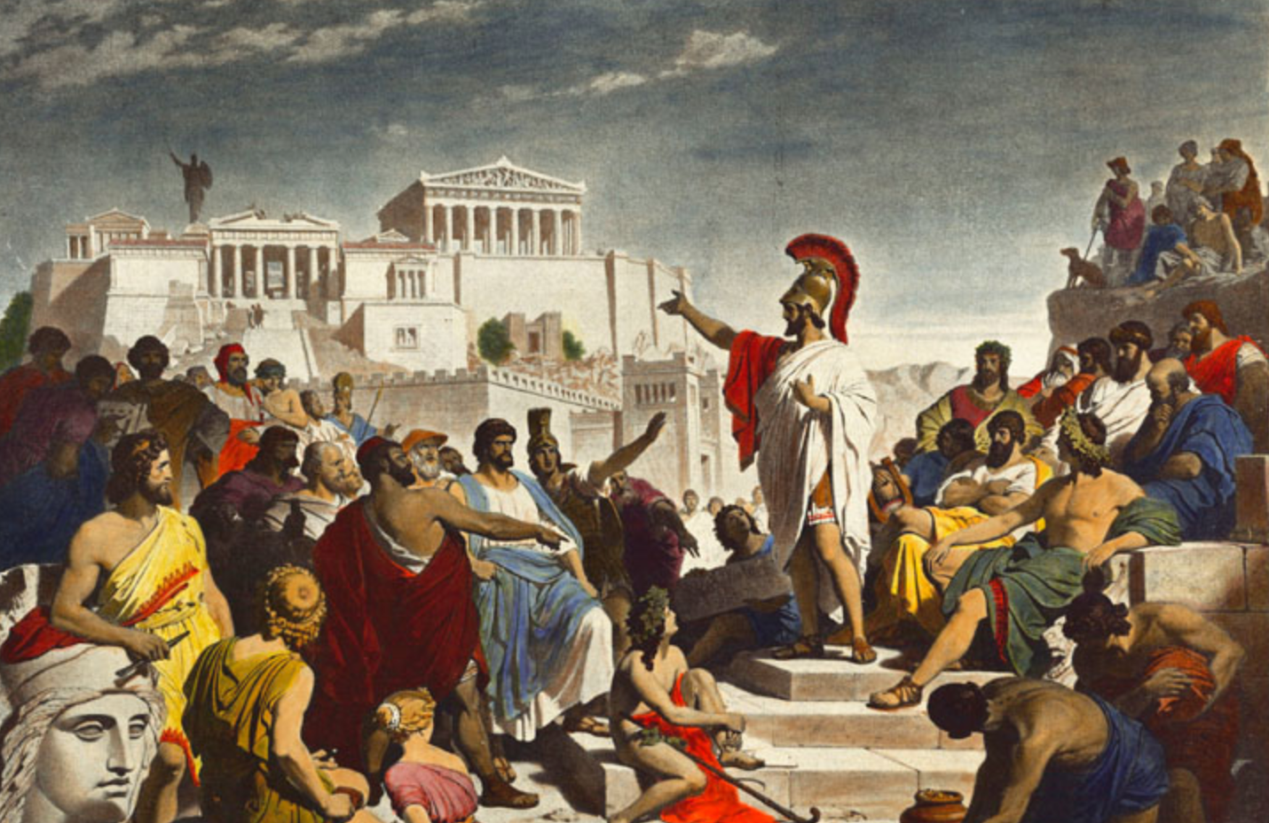
“Ruling and being ruled in turn”
5th and 4th Century Athens
Notes:
It meant that any free citizen could access the public sphere to make decisions in it with others on equal terms. It meant that all had an equal chance to be selected for the agenda-setting Council of 500 if they chose to volunteer to be on it. Over the course of a life-time each free Athenian was thus frequently in power, both “ruling and being ruled in turn” (Aristotle).

Slide 3

Modern representative democracies
the enclosure of power
s
Notes:
4 minutes
We see the progress compared to the monarchies that came before but if you compare it to the relevant comparison point, ancient democracy, you observe a de facto enclosure of power.
Modern Parliaments are inaccessible fortresses for most ordinary citizens. They’re opaque and the real deliberation does not even take place in parliamentary “debates” any more but in private committees and informal meetings prior to that. Ultimate architectural irony of the European Parliament and its transparent glass walls, when the building itself is a notorious maze and the institutions it represents are characterized by a massive democratic deficit
With representation, it seems, we lost openness
Was it unavoidable though?

Slide 4

The road(s) not taken
in the 18th Century
Notes:
What’s the likelihood that we made all the right design choices in the 18th century? What’s the likelihood that we evolved our institutional patterns from the right leitmotifs?

Slide 5
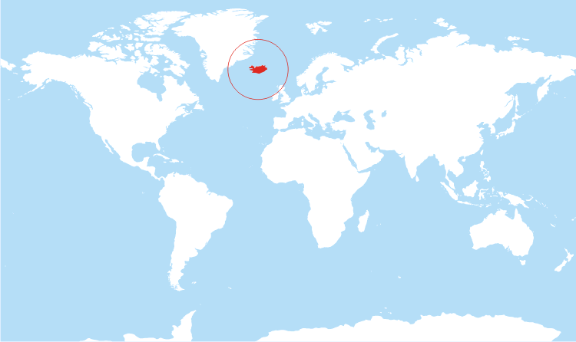
The Icelandic Experiment
Notes:
Because it’s a democratic laboratory and a sort of best case scenario. If it does not work there, it won’t work anywhere, that’s for sure but at least if it works there it means that as long as we have these kinds of conditions the ideal is not too crazy.
Postulate: no crucial difference between constitutional and ordinary law
People should write their own social contract, just as they should be responsible for ordinary policy-making
Crowdsourced constitutional process part of the rich archipelago of « democratic innovations »

Slide 6

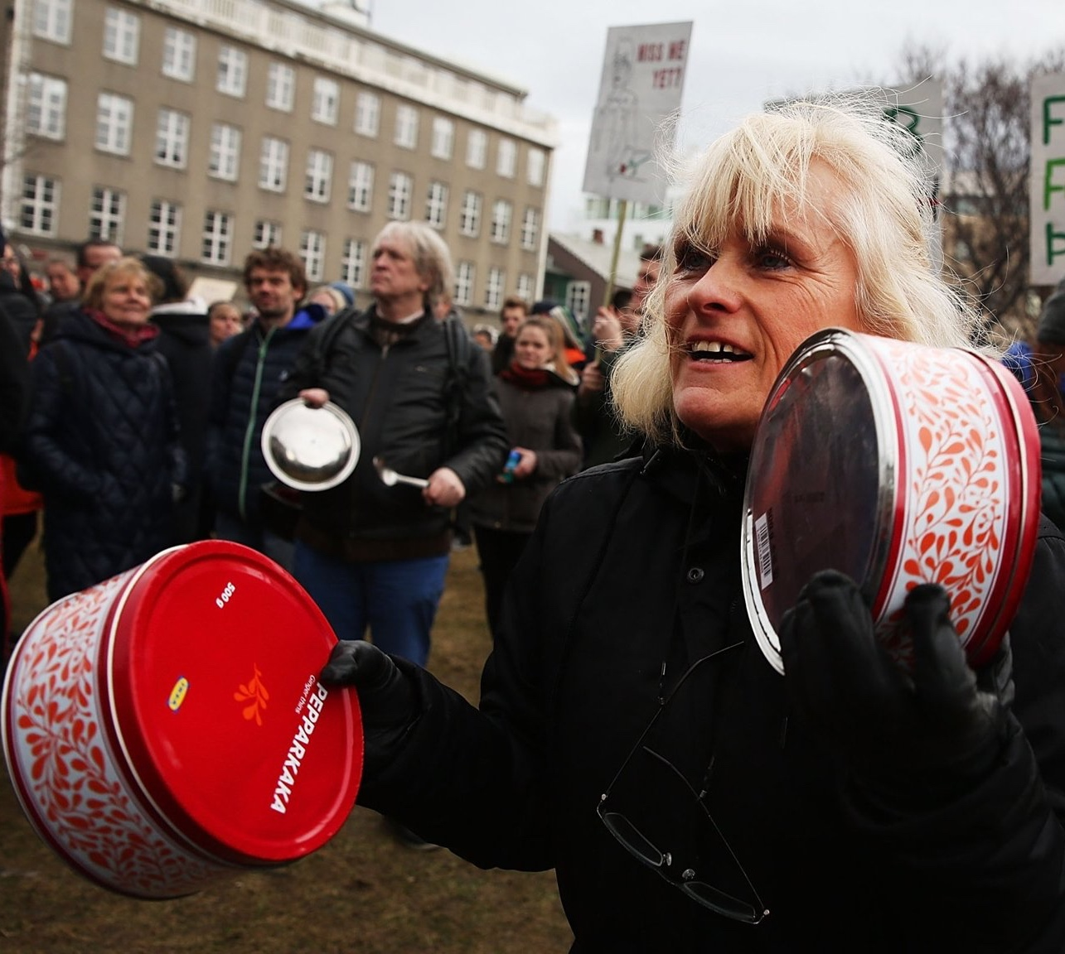

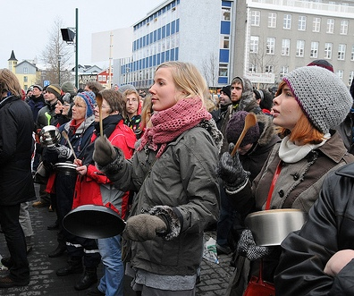
“Pots and Pans Revolution”
Iceland, Winter 2008-09
Notes:
Let me give you a quick reminder of the events that led to this Icelandic experiment.
In the fall of 2008, all four of the Icelandic national banks collapsed and Iceland entered into a deep financial and economic crisis. This crisis in turn spurred political protests against a government perceived as incompetent and corrupt, being in effect largely in cahoots with the small number of Icelandic entrepreneurs that had brought financial disaster on the country. The “pots and pans revolution” was born, with people protesting loudly, equipped with various kitchenware, in front of the Icelandic Parliament during the winter 2008–2009. While their main demands had little to do with a constitutional overhaul per se, the topic of constitutional change had been discussed for many years in Iceland, although not particularly in the years preceding the crisis. The change in political personnel, the following spring, brought to power proponents of such a constitutional change and gave the topic political momentum.
The reason for the general dissatisfaction with the existing constitution had to do with the fact that it was an archaic and obscure text, dating back to 1944, when Iceland obtained its independence from the Danish monarchy, and amended seven times since then; in reality, however, it was a faintly modified version of an earlier 19th century colonial constitution and marked by all sorts of idiosyncratic oddities. Many agreed that the resulting text was an awkward hybrid, ill-fitted for the modern, independent, and democratic republic of Iceland.

Slide 7
1. National Forum
s
950 quasi-randomly selected
citizens
Brainstorming of values and principles to be included in the new Constitution
Notes:
Upstream consultation of a representative sample of the people.
On 6 November 2010, a Constitutional Committee appointed by the
Parliament and the Anthill organized a second National Forum in cooperation
with each other—National Forum 2010. This second forum gathered 950
randomly selected individuals tasked with establishing “the principal viewpoints
and points of emphasis of the public concerning the organization of the country’s
government and its constitution.” These findings were meant to inspire a
constitutional draft reflective of the preferences of the Icelandic people.
The final draft
of the constitution contained many of the ideas present in the conclusions of
the National Forum, such as the public ownership of Iceland’s natural resources
(article 34), an article on information rights (article 15), and an attempt to
enshrine the Parliament’s role in the supervision of financial management (articles
68 to 72).

Slide 8

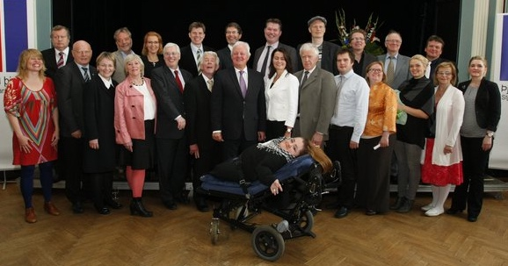
2. A Constitutional Assembly of
25 “Amateurs”
Notes:
a constitutional council of twenty-five individuals, 15 men, 10 women, many of them obscure (in the sense of being unknown of the larger public prior to running for election to the assembly) and all of them having little to no political experience whatsoever
The severely disabled woman is Freyja Haraldsdóttir. Being born with a condition known as bone glass disease did not stop her from, among other things, getting a university degree, becoming a human rights activist, and being elected to the Council, where she played an essential role in pushing through articles 6 and 7, respectively on equal rights and the right to life. For more on her rather extraordinary profile, see also http://www.stuff.co.nz/nelson-mail/news/9063777/Icelandic-woman-changes-mindsets
Only two out of twenty-five were thus former Parliamentarians (although several did hold positions in various parties, during or shortly after their involvement in the Council).
The twenty-five members of the Constitutional Council were initially elected out of a pool of 522 people who decided to run for elections, a pool from which, it is worth noting, parliamentarians and other professional politicians in function were officially excluded (by law). Ultimately the Council consisted of ten women and fifteen men and included the following self-declared professions: a university professor of economics, the director of the university of Iceland Ethics Institute, two media presenters, two physicians, a lawyer and radio presenter, two mathematicians, a farmer, a journalist, a manager, a lecturer in International Politics, a pastor, a reader of political science, the manager of the division of architecture at Reykjavik Art Museum, the chairman of Crowd Control Productions, a theater director, a university professor, a former museum director and teacher, a media presenter and university student, a lawyer, a trade union chairman, a political scientist and university student, a consumer spokesperson, and a film-maker and physician.

Slide 9

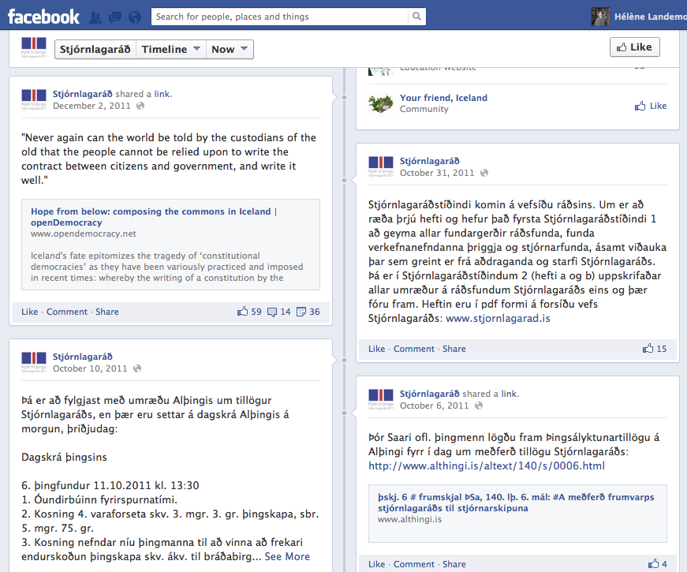
3. The Crowdsourcing Stage
Notes:
The 25 members of the Council, far from isolating themselves from popular input, regularly posted online, for the world to see and for the Icelandic people to read, the version of the draft they were working on. All in all, they posted 12 drafts, all at various stages of completion. Anyone interested in the process could post comments and send feedback using social media like Facebook and Twitter, or using regular email and mail. In fact, foreigners themselves were free to participate if they could find a way (e.g., Googlechrome) to overcome the language barrier .
it is worth noting that only 3, 600 comments were made on the Facebook page. Each of these comments started a conversation of various lengths, consisting of threaded responses following the initial comment. Ultimately, only 360 suggestions emanated from a population of 320,000 or so. This is not exactly mass participation. If you think of it, though, 360 people are more than twenty-five. On top of the weak participation, one may argue that not enough was done to ensure participation of older, less technologically savvy individuals.
I assume, perhaps optimistically, that each suggestion was made by a different person and I also ignore the added difficulty of comparing numbers reflecting very different selection methods (self-selection in one case, election in the other) and thus groups with different degrees of legitimacy.
While there was no conscious intention on the part of the Council members to establish a systematic back and forth between them and the crowd, something close to such a feedback loop seemed to have emerged from the very first draft onwards. The first draft was thus not a full first draft and contained only the main “headings” or “chapters.” Once the structure was first exposed to comments, the Council proceeded to integrate some of the remarks and write up the actual texts corresponding to each “heading.” The text was fleshed out progressively, reactively, over several iterations of the same process: write a little more, show it to the crowd, integrate their comments when judged necessary or useful, and make changes according to suggestions, add a little more, and so on. When time ran out, the Council generated a consensus on the draft they had, which was to a degree a compromise of the various visions and inputs. Thank you to Salvör Nordal for this information. Personal communication May 20, 2013.
For example, the right to Internet expressed in article 14 came straight from the crowd.

Slide 10

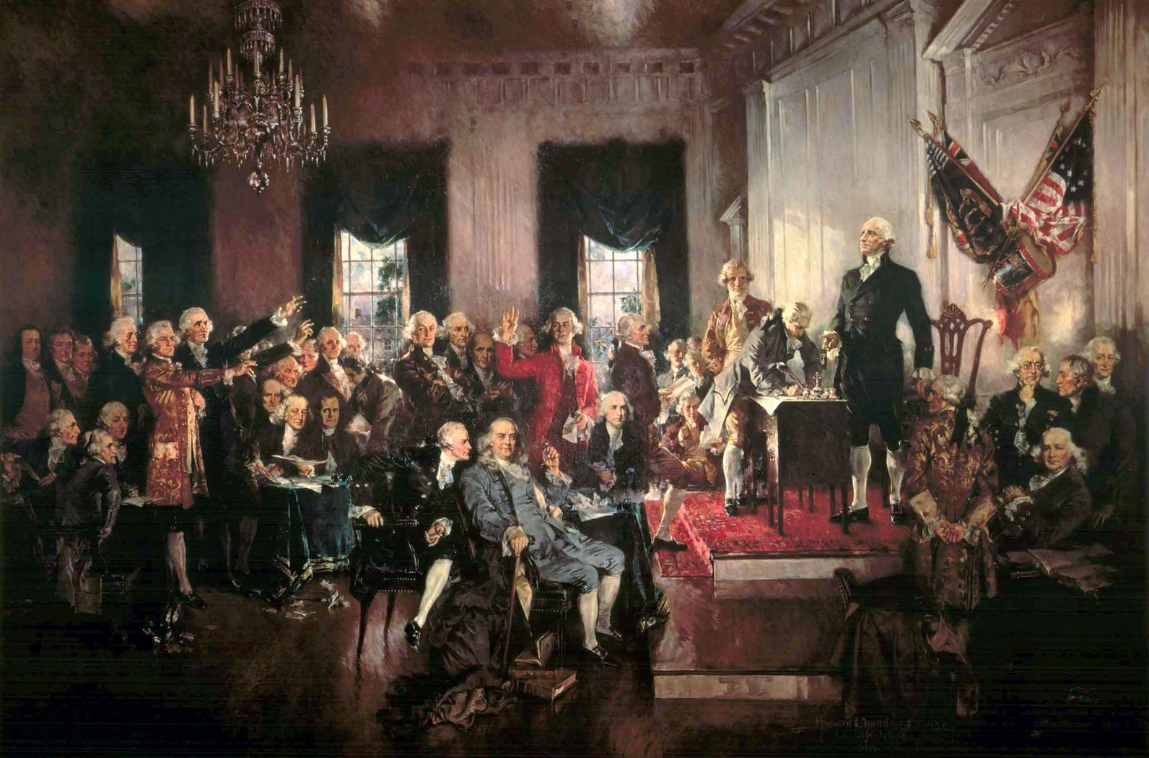
Contrast with…
Howard Chandler Christy,
The Signing of the Constitution (1940)
Notes:
The delegates agreed to keep their deliberations secrete until they reached a conclusion.
Model of the Supreme Court rather than Congress.
Although the Convention was intended to revise the Articles of Confederation, the intention from the outset of many of its proponents, chief among them James Madison and Alexander Hamilton, was to create a new government rather than fix the existing one.
Disagreement: The most contentious disputes revolved around the composition and election of theSenate, how "proportional representation" was to be defined (whether to include slaves or other property), whether to divide the executive power between three persons or invest the power into a single president, how to elect the president, how long his term was to be and whether he could stand for reelection, what offenses should be impeachable, the nature of a fugitive slave clause, whether to allow the abolition of the slave trade, and whether judges should be chosen by the legislature or executive.

Slide 11

Or European Constitution and Treatises
Signing of the Treaty of Rome, March 25, 1957.
Notes:
Written by experts, signed in Rome in October 2004 but never approved because it was rejected in various referenda (France and Netherlands). United-Kingdom in 2006 suspends the ratifying process.
2007: Treaty of Lisbon is signed, which becomes the de facto “constitution.” It was written in a completely opaque manners by bureaucrats, members of an “intergovernmental conference”, legal experts, industrialists, and a handful of representatives of the European Union.

Slide 12


Opening democracy to ordinary citizens:
Could we do this elsewhere and for ordinary law-making?
Notes:
In terms of openness and inclusivenes: two models: hour-glass shape or fully open/inclusive
Some people have argued that the ideal Constitutional Process is hour-glass shaped, with a moment for wide public consultation upstream of the process and downstream of the process. But crucially the writing process itself is supposed to be ideally restricted to a few people who insulate themselves from the passions and pressures of the outside world. Having a select few was always considered a guarantee of quality of the thoughts going into the draft; the secrecy was considered a guarantee of their impartiality, lack of bias.
What has never been argued for is the idea of a fully open, completely inclusive and transparent constitution-making process. Perhaps a crowdsourced wiki? But in any case the Icelandic case is somewhat intermediary, less open and inclusive than the cyindric model if you will, but more inclusive and open in crucial ways than historical precedents or even the ideal of the hour-glass shaped put forward by some theorists.

Slide 13
Open Democracy
Empowerment rights
Democratic deliberation
Majoritarian Principle
Complex representation
Notes:
Principles: General guidelines for institutitional designs These principles are more abstract than Bernard Manin’s historically steeped principles but institutionally more detailed than Dahl’s purely normative benchmarks. Indeed they are meant as ways to approximate Dahl’s normative benchmarks.
I introduce them in what I take to be their logical order of priority and importance. All together these six principles aim to institutionalize the ideal of popular rule as equal opportunity to participate in self-rule.
The first two principles—inclusiveness and equality—are the fundamental pillars of democracy. As such they are not specific to post-representative democracy and could potentially be omitted from the list, though they would have to be assumed throughout as lexically prior to any of the other principles. However, it probably does not hurt to have them explicitly stated rather than left implicit or tied too narrowly to only one type of equality (voting equality, as in Dahl’s list) or one type of inclusion (electoral, as in Manin’s list).
Inclusiveness means both that every adult member of the demos is entitled to a share of power and that the definition of the demos itself is inclusive. Equality means that this share of power must be equal for all. In practice equality can still mean one person one vote where and if voting is needed. It also means that each voice is given the same ex ante chance of being heard where deliberation is needed. Finally, it can mean that each individual has the same chance of being a representative where representation is needed.
The third principle, deliberation, is a core principle of political legitimacy that deliberative democrats have convincingly officially added to the previous two, though one could make the case that this principle was present in ancient democracy (see Pericles’ Oratio). By itself it is not a democratic principle. What makes it so is its being constrained by the previous two. Deliberation must take place publicly, as well as between all on an equal basis, in order to count as democratic. In effect, the principle of deliberation counterbalances the equality principle by imposing substantive merit of the argument and information put forward as a condition of legitimacy. Indeed, though all should have an equal chance of being heard, arguments will be judged on the merits and therefore not all voices will equally influence the outcome. The “deliberation” principle is similar to Manin and Urbinati’s “trial by discussion” principle, except that deliberation is not assumed to take place only among elected elites (as on Manin’s model) nor is it assumed to involve ordinary citizens only as members of a diffuse civil society without direct decision-power (as in Habermas or Urbinati’s model). Democratic deliberation, whether it involves all citizens or their representatives only, must involve ordinary citizens. This principle helps ensure that the system meets the requirement of “enlightened understanding.”
The majoritarian principle is, strangely, the principle that risks making most people recoil, including Dahl, who did not see the need to list it as a democratic criterion. Yet it is also the principle most widely associated with democracy (above and beyond elections) and it seems strange to have a definition of democracy that does not somehow include it. To the extent that voting is necessary to resolve disagreements where deliberation does not produce a consensus, some sort of default decision rule must be in place. The most democratic one, barring any good countervailing arguments to posit voting thresholds and minority vetoes, is some version of majority rule (for which both strictly procedural and epistemic reasons can be adduced). While majority rule is too often reviled for its alleged propensity to enable the “tyranny of the majority,” it is also a rule that prevents the domination of any minority. To the extent that limits on majority rule are necessary (which they are), they need to be introduced on the basis of “liberal” (usually counter-majoritarian) arguments, not democratic ones, which is why I leave such restrictions outside of the definition of post-representative democracy.
The fourth principle, representation, acknowledges that some delegation of authority is necessary as well as desirable for both purposes of feasibility in large-scale polities and greater deliberative reflexivity. Constrained by the more fundamental principles of inclusiveness and equality, representation, however, translates not into elections but selection by lottery. Thus, no mention is made in this list of the principle of elections (not even periodic ones) because elections, far from being a, let alone the democratic principle, are merely one selection mechanism among others capable of translating the representative principle in a democratic fashion. It is, after all, possible to imagine elections falling closer to democracy than they currently do on the continuum between oligarchic and democratic device (see Gastil 2000). But the reality is that elections are a fundamentally Janus-faced selection mechanism (Manin 1997). Because their democratic credentials are problematic, elections should not be raised to the level of democratic principle. One could in fact imagine democracies that would do away with elections entirely, if elections proved too difficult to reconcile with equality of opportunities to become a representative (implied by the equality principle). Post-representative democracies could use other selection mechanisms with their own democratic merits. In addition to sortition, self-selection and self-authorization come to mind.
Rotation, as a sixth principle, is essential to ensure that power be made to circulate and not stay with any subset of the polity for longer than strictly necessary. In the context of randomly selected assemblies, periodic rotation would have the beneficial effects of preventing group think, the formation of static coalitions, corruption, and the creation of a separate class of rulers. The mandates for randomly selected assemblies or elected ones could last from a few months to a few years, but this principle makes it clear that the practice of politics as a profession and politicians as a separate cast is not part of this new ideal of democracy. While there should be plenty of room for expert administrators in the machinery of government, the law and policy-decisions should ultimately be vetted by ordinary citizens (properly educated for and informed about the tasks at hand), not career politicians. To the extent that post-representative democracy may still accommodate elected politicians, there should also be ways to ensure a greater turnover of the personnel occupying these elected functions, not just through the periodicity of elections (which, as we now know, may ensure some responsiveness and accountability but does very little for actual turnover of the political personnel), but also, for example, through strict limits on the number of mandates.
Openness, finally, is an umbrella concept for popular participation of different types as well as transparency. Because representation always creates the risk of robbing the people of the right to effective participation, agenda-setting, and enlightened understanding, one needs to introduce the counterbalancing principle of openness, which guarantees that citizens can make their voices generally heard at any point in time, initiate laws when they are not satisfied with the agenda set by representative authorities, or simply keep an informed eye on what is going on at every step of the political process.
Openness thus prevents the closure and entrenchment of the divide between represented and representatives that may accompany representation. Openness means that power should flow through the body politic, as opposed to stagnating with a few people. Openness will translate into process transparency much of the time (though not always transparency about substance). It should also translate into a constitutional citizens’ initiative right and other modes of direct and effective participation. This principle of openness is arguably the most distinctive, in that it is uniquely enabled by late 20th and early 21st century technologies, such as the internet, smart phones, and social media.
The exact criterion for inclusiveness may be too controversial to specify further, as the all affected interests principle (Goodin 2005) is often seen as too general and any restriction based on nationality, geography, or ethnicity too arbitrary.
See for example Maski and Sen 2016 on how majority rule would have prevented the rise of Trump.
A defense of election-less democracies was recently offered for example by Van Reybrouk 2016.
Openness is also the defining principle of the Obama administration’s latest attempt at salvaging representative democracy with the timely concept of “open government.” Though the implementation fell short of the promise, the concept remains enticing as an umbrella for various democratic values such as transparency, participation, and collaboration. I use it in the same sense, though I leave “collaboration” out for the sake of parsimony, as one form of participation that need not be spelled out explicitly.

Slide 14

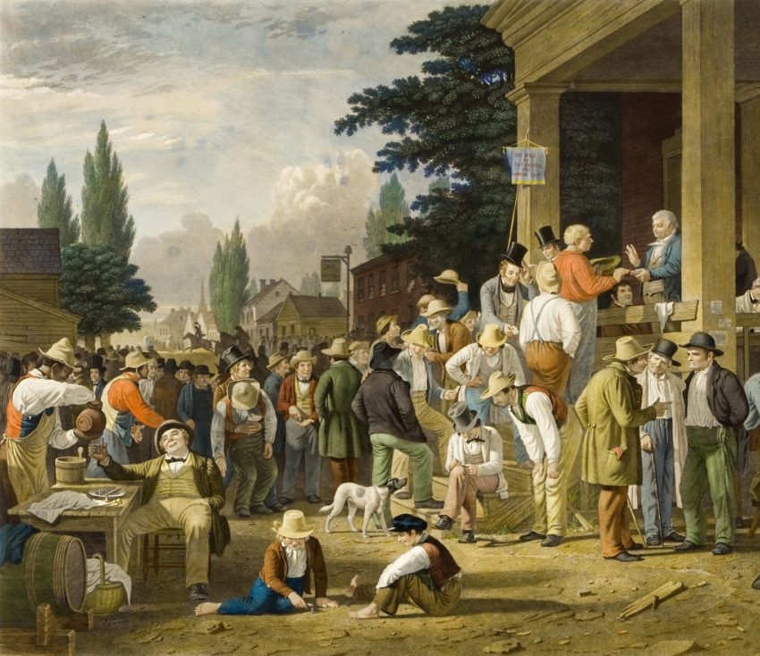
“Lottocratic” representation
e.g.,
Citizens’ Assemblies
Deliberative Polls
National Forums
Citizen Juries
G-1000…
Notes:
Their legitimacy come from equal chances of being selected and impartiality [what else?]
Randomly selected forums of 12 to 500 citizens.
Include Citizens’ Assemblies, Deliberative Polls etc.

Slide 15

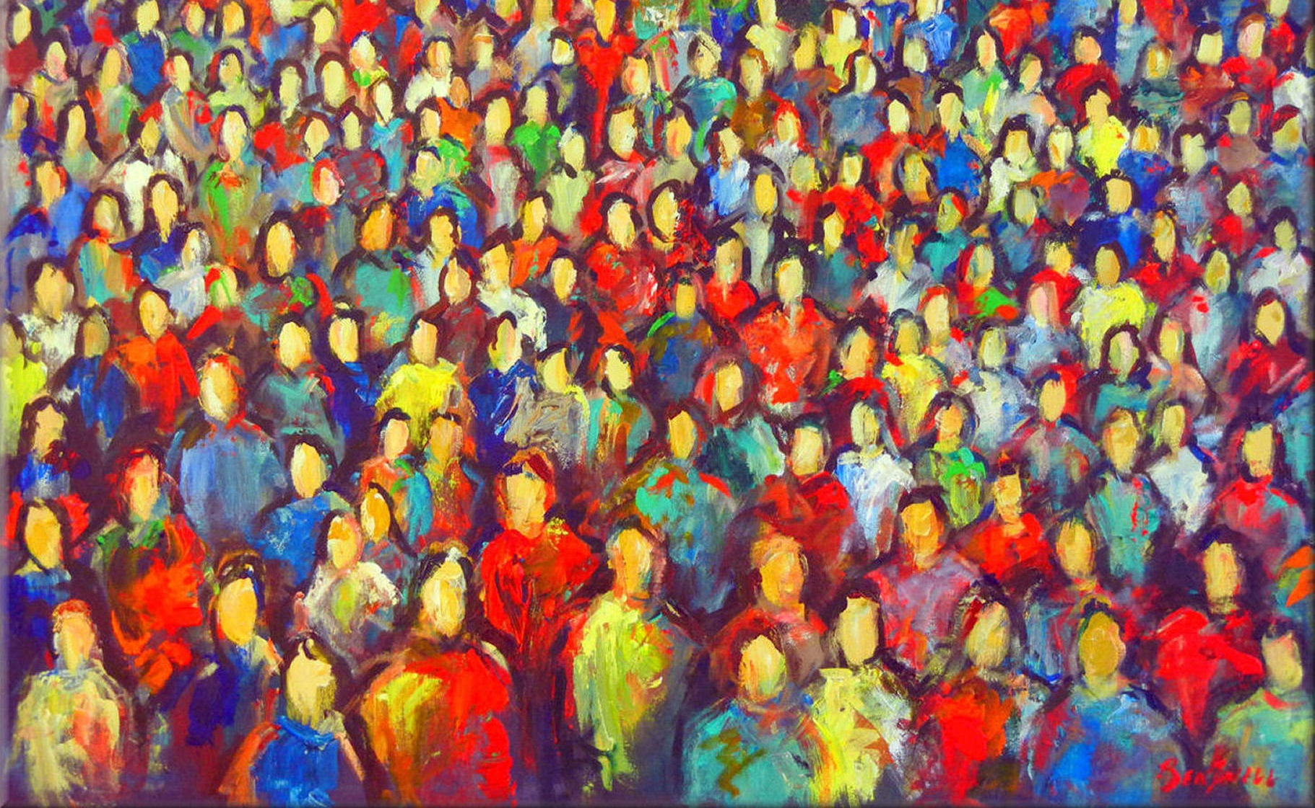
“Crowdsourced” Representation
Notes:
Legitimacy comes from equal opportutinity of participation; tacit consent of those who don’t participate to a degree.

Slide 16

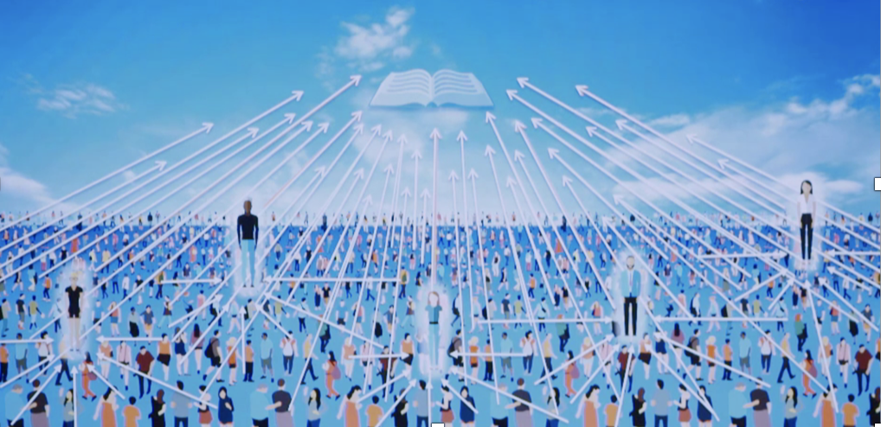
Electoral Representation*?
Models of “delegative” of “liquid” democracy
Notes:
The prototypical delegative democracy has been summarized by Bryan Ford in his paper, Delegative Democracy, as containing the following principles:^{[3]}
Choice of role: Each member can choose to take either a passive role as an individual or an active role as a delegate, differentiating this from representative forms in which only specified representatives are allowed. Delegates have further choices as to how active they are and in what areas.
Low barrier to participation: The difficulty and cost of becoming a delegate is small, and in particular does not require political campaigning or winning a competitive election.
Delegated authority: Delegates exercise power in organizational processes on behalf of themselves and those individuals who select them as their delegate. Different delegates, therefore, can exercise varying levels of decision power.
Privacy of the individual: To avoid social pressures or coercion, all votes made by individuals are private, both from other individuals and from delegates.
Accountability of the delegates: To ensure the accountability of delegates to their voters and to the community at large, all formal deliberative decisions made by delegates are completely public (or in some forms viewable only to their constituents).
Specialization by re-delegation: Delegates can not only act directly on behalf of individuals as generalists, but through re-delegation they can also act on behalf of each other as specialists.
Some key differences with representative democracy include:
Optionality of term lengths.
Possibility for direct participation.
The delegate's power is decided in some measure by the voluntary association of members rather than an electoral victory in a predefined jurisdiction. (See also: Single transferable vote.)
Delegates remain re-callable at any time and in any proportion.
Often, the voters have the authority to refuse observance of a policy by way of popular referendum overriding delegate decisions or through nonobservance from the concerned members. This is not usually the case in representative democracy.
Possibility exists for differentiation between delegates in terms of what form of voting the member has delegated to them. For example: "you are my delegate on matters of national security and farm subsidies

Slide 17
institutional principles
6
Empowerment rights
Democratic deliberation
Majoritarian Principle
Complex representation
Rotation
Transparency
Notes:
Principles: General guidelines for institutitional designs These principles are more abstract than Bernard Manin’s historically steeped principles but institutionally more detailed than Dahl’s purely normative benchmarks. Indeed they are meant as ways to approximate Dahl’s normative benchmarks.
I introduce them in what I take to be their logical order of priority and importance. All together these six principles aim to institutionalize the ideal of popular rule as equal opportunity to participate in self-rule.
The first two principles—inclusiveness and equality—are the fundamental pillars of democracy. As such they are not specific to post-representative democracy and could potentially be omitted from the list, though they would have to be assumed throughout as lexically prior to any of the other principles. However, it probably does not hurt to have them explicitly stated rather than left implicit or tied too narrowly to only one type of equality (voting equality, as in Dahl’s list) or one type of inclusion (electoral, as in Manin’s list).
Inclusiveness means both that every adult member of the demos is entitled to a share of power and that the definition of the demos itself is inclusive. Equality means that this share of power must be equal for all. In practice equality can still mean one person one vote where and if voting is needed. It also means that each voice is given the same ex ante chance of being heard where deliberation is needed. Finally, it can mean that each individual has the same chance of being a representative where representation is needed.
The third principle, deliberation, is a core principle of political legitimacy that deliberative democrats have convincingly officially added to the previous two, though one could make the case that this principle was present in ancient democracy (see Pericles’ Oratio). By itself it is not a democratic principle. What makes it so is its being constrained by the previous two. Deliberation must take place publicly, as well as between all on an equal basis, in order to count as democratic. In effect, the principle of deliberation counterbalances the equality principle by imposing substantive merit of the argument and information put forward as a condition of legitimacy. Indeed, though all should have an equal chance of being heard, arguments will be judged on the merits and therefore not all voices will equally influence the outcome. The “deliberation” principle is similar to Manin and Urbinati’s “trial by discussion” principle, except that deliberation is not assumed to take place only among elected elites (as on Manin’s model) nor is it assumed to involve ordinary citizens only as members of a diffuse civil society without direct decision-power (as in Habermas or Urbinati’s model). Democratic deliberation, whether it involves all citizens or their representatives only, must involve ordinary citizens. This principle helps ensure that the system meets the requirement of “enlightened understanding.”
The majoritarian principle is, strangely, the principle that risks making most people recoil, including Dahl, who did not see the need to list it as a democratic criterion. Yet it is also the principle most widely associated with democracy (above and beyond elections) and it seems strange to have a definition of democracy that does not somehow include it. To the extent that voting is necessary to resolve disagreements where deliberation does not produce a consensus, some sort of default decision rule must be in place. The most democratic one, barring any good countervailing arguments to posit voting thresholds and minority vetoes, is some version of majority rule (for which both strictly procedural and epistemic reasons can be adduced). While majority rule is too often reviled for its alleged propensity to enable the “tyranny of the majority,” it is also a rule that prevents the domination of any minority. To the extent that limits on majority rule are necessary (which they are), they need to be introduced on the basis of “liberal” (usually counter-majoritarian) arguments, not democratic ones, which is why I leave such restrictions outside of the definition of post-representative democracy.
The fourth principle, representation, acknowledges that some delegation of authority is necessary as well as desirable for both purposes of feasibility in large-scale polities and greater deliberative reflexivity. Constrained by the more fundamental principles of inclusiveness and equality, representation, however, translates not into elections but selection by lottery. Thus, no mention is made in this list of the principle of elections (not even periodic ones) because elections, far from being a, let alone the democratic principle, are merely one selection mechanism among others capable of translating the representative principle in a democratic fashion. It is, after all, possible to imagine elections falling closer to democracy than they currently do on the continuum between oligarchic and democratic device (see Gastil 2000). But the reality is that elections are a fundamentally Janus-faced selection mechanism (Manin 1997). Because their democratic credentials are problematic, elections should not be raised to the level of democratic principle. One could in fact imagine democracies that would do away with elections entirely, if elections proved too difficult to reconcile with equality of opportunities to become a representative (implied by the equality principle). Post-representative democracies could use other selection mechanisms with their own democratic merits. In addition to sortition, self-selection and self-authorization come to mind.
Rotation, as a sixth principle, is essential to ensure that power be made to circulate and not stay with any subset of the polity for longer than strictly necessary. In the context of randomly selected assemblies, periodic rotation would have the beneficial effects of preventing group think, the formation of static coalitions, corruption, and the creation of a separate class of rulers. The mandates for randomly selected assemblies or elected ones could last from a few months to a few years, but this principle makes it clear that the practice of politics as a profession and politicians as a separate cast is not part of this new ideal of democracy. While there should be plenty of room for expert administrators in the machinery of government, the law and policy-decisions should ultimately be vetted by ordinary citizens (properly educated for and informed about the tasks at hand), not career politicians. To the extent that post-representative democracy may still accommodate elected politicians, there should also be ways to ensure a greater turnover of the personnel occupying these elected functions, not just through the periodicity of elections (which, as we now know, may ensure some responsiveness and accountability but does very little for actual turnover of the political personnel), but also, for example, through strict limits on the number of mandates.
Openness, finally, is an umbrella concept for popular participation of different types as well as transparency. Because representation always creates the risk of robbing the people of the right to effective participation, agenda-setting, and enlightened understanding, one needs to introduce the counterbalancing principle of openness, which guarantees that citizens can make their voices generally heard at any point in time, initiate laws when they are not satisfied with the agenda set by representative authorities, or simply keep an informed eye on what is going on at every step of the political process.
Openness thus prevents the closure and entrenchment of the divide between represented and representatives that may accompany representation. Openness means that power should flow through the body politic, as opposed to stagnating with a few people. Openness will translate into process transparency much of the time (though not always transparency about substance). It should also translate into a constitutional citizens’ initiative right and other modes of direct and effective participation. This principle of openness is arguably the most distinctive, in that it is uniquely enabled by late 20th and early 21st century technologies, such as the internet, smart phones, and social media.
The exact criterion for inclusiveness may be too controversial to specify further, as the all affected interests principle (Goodin 2005) is often seen as too general and any restriction based on nationality, geography, or ethnicity too arbitrary.
See for example Maski and Sen 2016 on how majority rule would have prevented the rise of Trump.
A defense of election-less democracies was recently offered for example by Van Reybrouk 2016.
Openness is also the defining principle of the Obama administration’s latest attempt at salvaging representative democracy with the timely concept of “open government.” Though the implementation fell short of the promise, the concept remains enticing as an umbrella for various democratic values such as transparency, participation, and collaboration. I use it in the same sense, though I leave “collaboration” out for the sake of parsimony, as one form of participation that need not be spelled out explicitly.

Slide 18
5. Rotation
s
Principle of resistance to closure and elite-entrenchment: “power corrupts”
Notes:
Ensures that power circulates and democracy remains the rule of political amateurs
Democracies are fragile. The last two principles can be seen as conditions for the other principles to resist closure over time .
Rotation ensures that power be made to circulate and not stay with any subset of the polity for longer than strictly necessary. It is the only way to ensure that ordinary citizens, though empowered to make decisions on the rest of their peers and turned into de facto temporary political “elites” in this respect, do not, however, turn into permanent elites in the sociological sense. Rotation, in other words, prevents the creation of a permanent and separate class of rulers. Additionally, periodic rotation has the beneficial effects of preventing groupthink, the formation of static coalitions, and some amount of corruption (the systemic kind, though no system, including one based on rotation, can be made immune to the occasional bribe).
Could mean in practice short term limits for elected leaders to avoid the kind of pathetic turnover of the American Congress (less than 5%).

Slide 19


6. Transparency
x
“Light is the best disinfectant”
Notes:
Another principle of resistance to closure

Slide 20
Main Institutional Recommendation
s
The Open Mini-Public
Notes:
Giulia:: when you talk about experiments and inductive theory, comes up against and against
Repairing the ship at sea: both gradual and radical, both continuity and rupture.
Add a picture of a ship repaired to sea, google s picture.

Slide 21

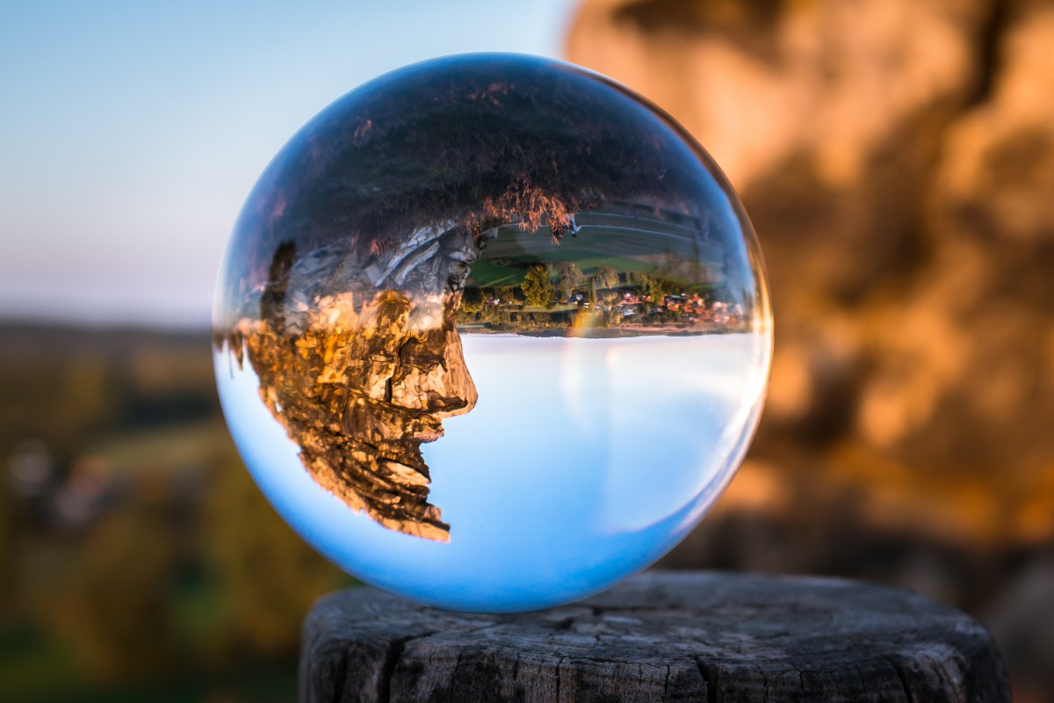
Notes:
A different way to think of popular rule and thus to see problems with existing institutions as well as institutional fixes for it.

Slide 22
Thank you!

